Slide 1
Biopotential
Siyi Li
College of Engineering and Computing, Miami University
CPB 328: Bioinstrumentation
May 1, 2025

Slide 2
What is Biopotential?
Definition Biopotential refers to electrical signals generated by living cells or tissues due to ionic activity across membranes.
Key Features
Originates from excitable cells (neurons, muscle cells, etc.)
Measurable using electrodes and amplifiers
Reflects physiological processes (e.g., heartbeat, brain activity)

Slide 3
Types of Biopotential Applications
Biopotential Signals
ECG (Electrocardiography)
EMG (Electromyography)
EEG (Electroencephalography)
ENG (Electroneurography)
ERG (Electroretinography)
Non-Biopotential Imaging Techniques
CT (Computed Tomography)
Echocardiogram

Slide 4
Biopotential Signal Characteristics
Biopotential Type | Source | Frequency Range | Amplitude | Common Applications
ECG (Electrocardiogram) | Cardiac muscle (heart) | 0.05 – 150 Hz | 0.05 – 4 mV | Heart monitoring, arrhythmia detection
EMG (Electromyogram) | Skeletal muscle | 20 – 500 Hz (up to 1 kHz) | 50 μV – 30 mV | Muscle function testing, prosthetics control
EEG (Electroencephalogram) | Cerebral cortex (brain) | 0.5 – 50 Hz | 10 – 200 μV | Seizure diagnosis, sleep studies, BCI
ENG (Electroneurogram) | Peripheral nerves | 1 – 10 kHz | 1 – 5 mV | Nerve conduction studies
ERG (Electroretinogram) | Retina (eye) | 0.3 – 150 Hz | ~100 – 800 μV | Retinal disease diagnosis

Slide 5
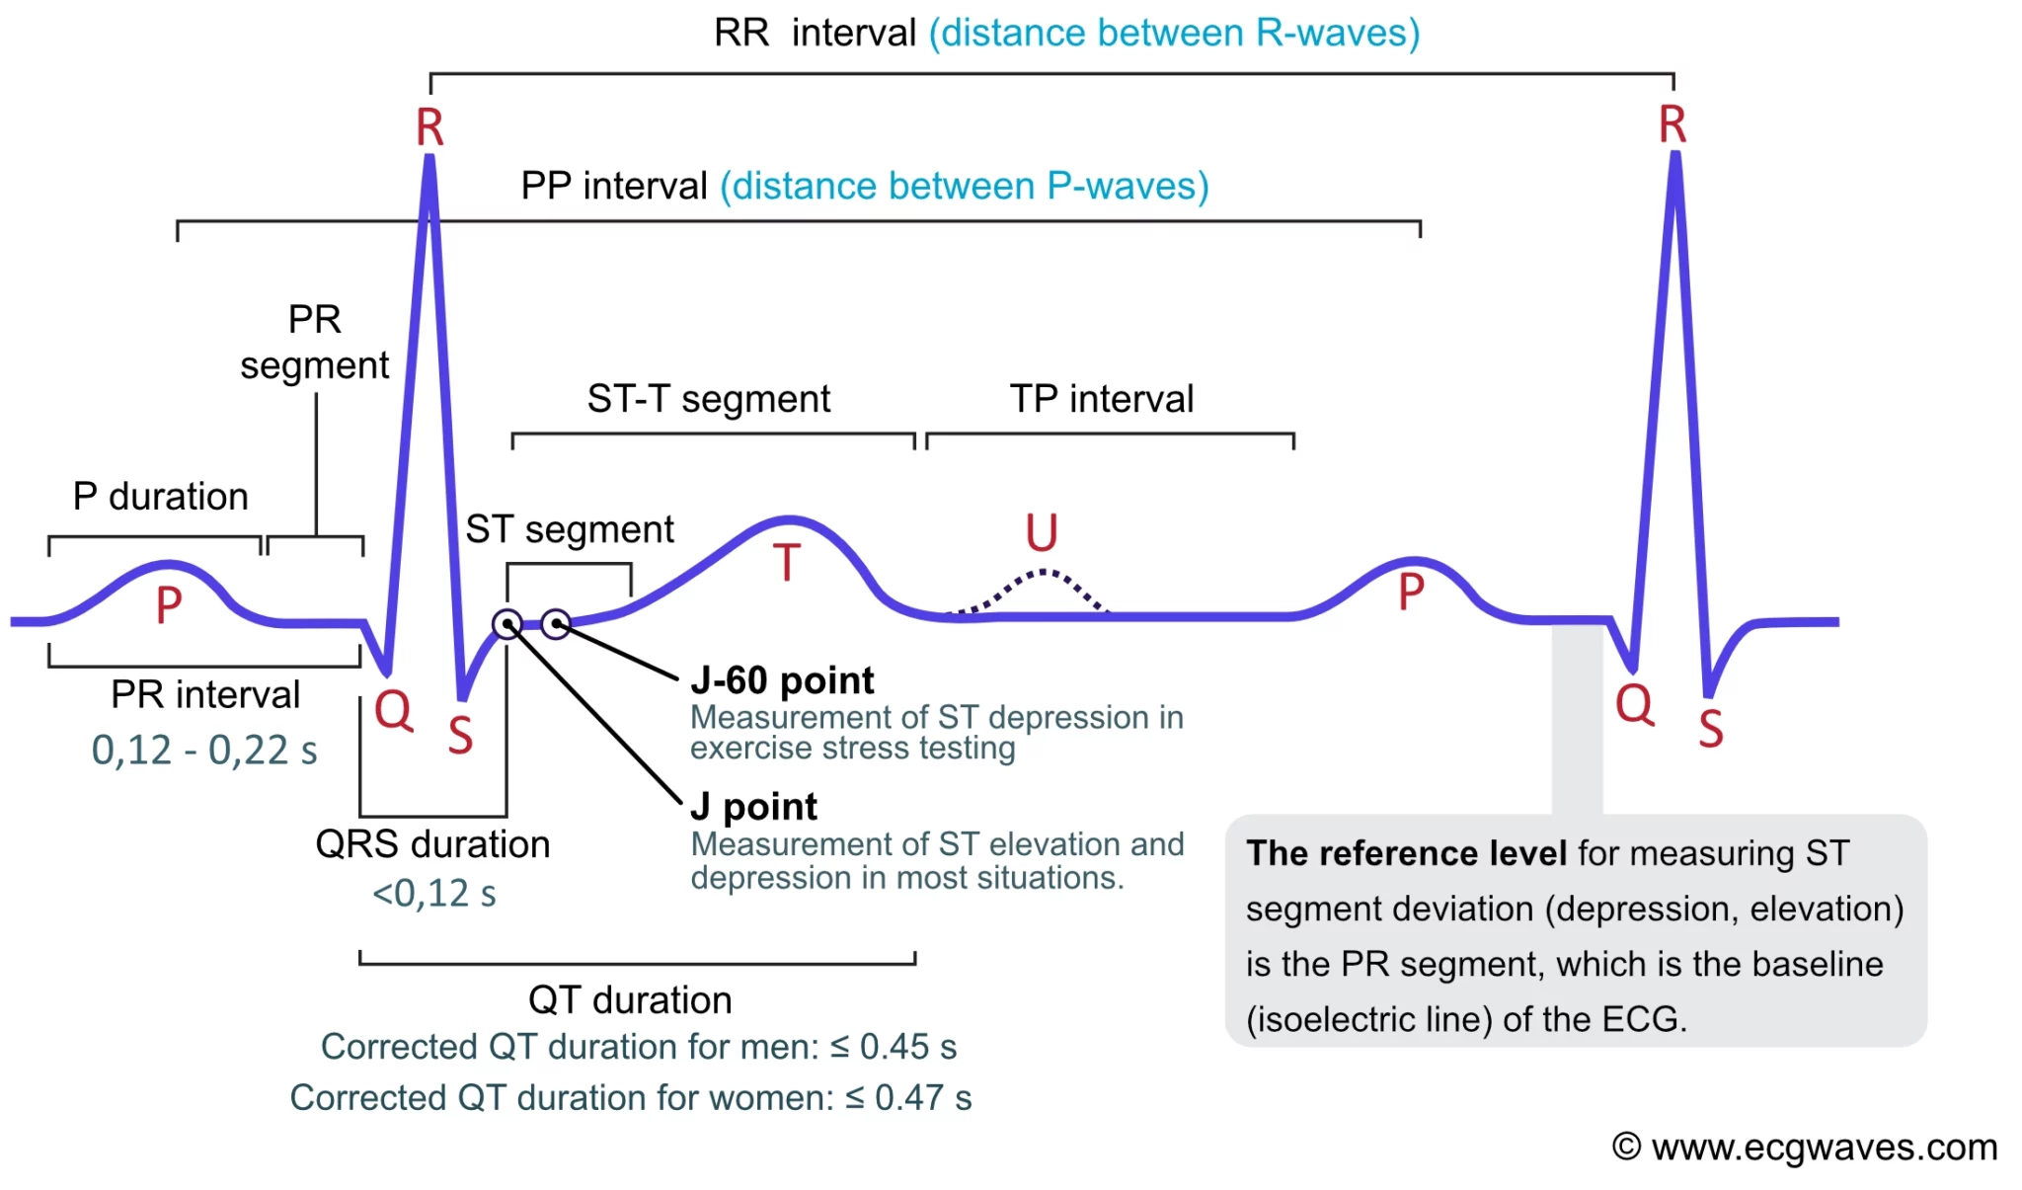
ECG Sample Signal Waveforms
P-QRS-T Complex
Fig. 1 Sample ECG waveform. Adapted from ecgwaves.com[1].

Slide 6
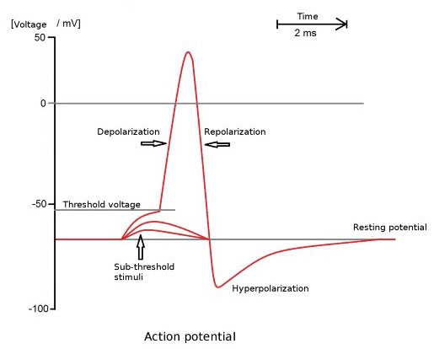
EMG Sample Signal Waveforms
Bursts during voluntary muscle activity
Fig. 2 EMG signals reflect muscle action potentials, with characteristic phases of depolarization, repolarization, and hyperpolarization[2].

Slide 7
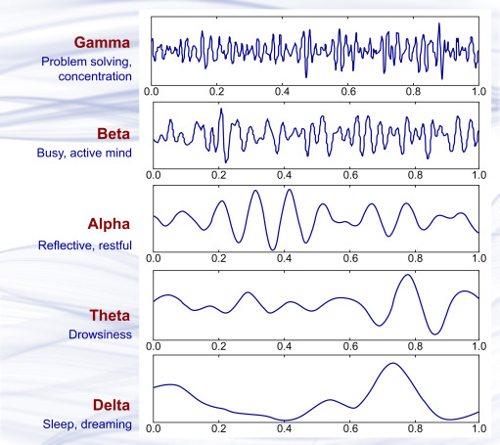
EEG Sample Signal Waveforms
Alpha
Beta
Delta
Theta
Gamma
all rhythms
Fig. 3 Characteristics of the five basic EEG brain waves, showing frequency bands and associated mental states[3].

Slide 8
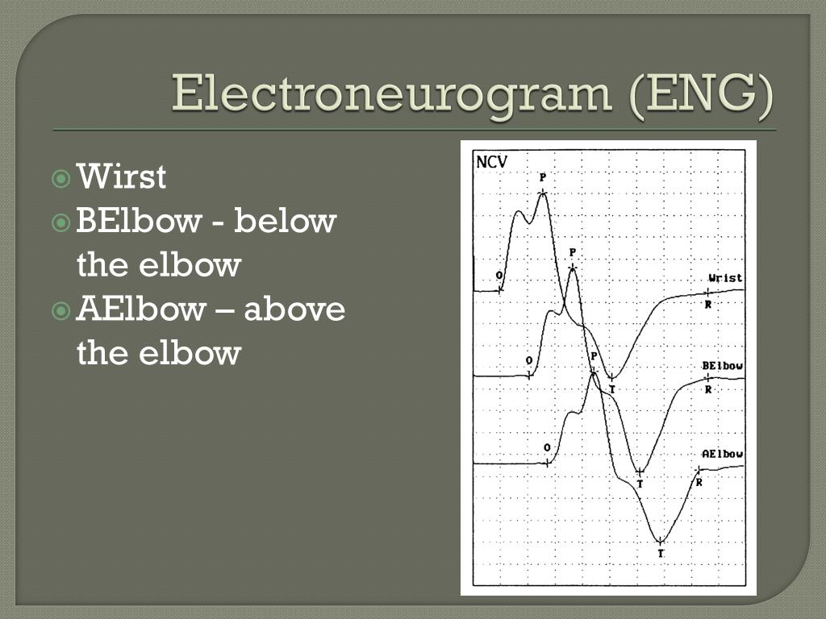
ENG Sample Signal Waveforms
The compound nerve action potential (CNAP), which is the summed electrical response of multiple nerve fibers to a stimulus.
Fig. 4 A typical electroneurogram (ENG) waveform displays compound action potentials from peripheral nerves[4].

Slide 9
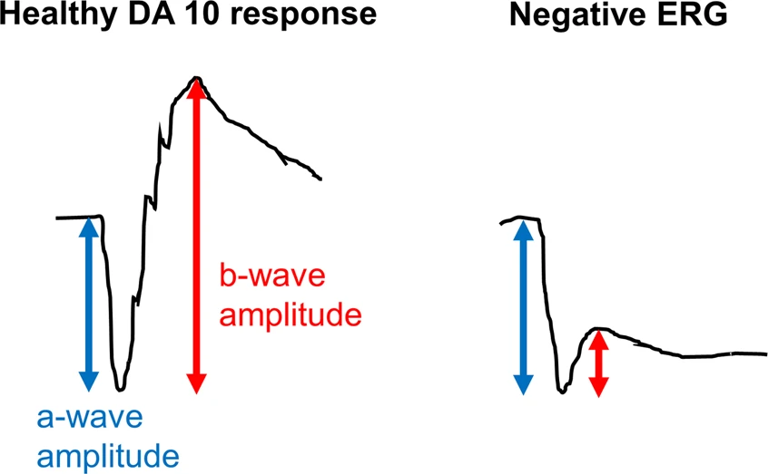
ERG Sample Signal Waveforms
a-wave
b-wave
response to light
Fig. 5 Comparison between normal and negative ERG responses, showing differences in a-wave and b-wave amplitudes[5].

Slide 10
Non-Biopotential Imaging Techniques
Modality | Type | Application | Frequency | Amplitude
CT (Computed Tomography) | X-ray imaging | Cross-sectional imaging of internal organs, bone fractures, tumors | 30–150 kV (X-ray photon energy) | N/A
Echocardiogram | Ultrasound imaging | Visualizing heart chambers, valves, motion, and blood flow | 2–10 MHz (ultrasound wave) | Mechanical wave pressure amplitude
CT and echocardiogram are not biopotential-based. They detect structural or flow-related information via radiation or ultrasound, not electrical activity. Therefore, they have no voltage/current amplitude like EEG/ECG.

Slide 11
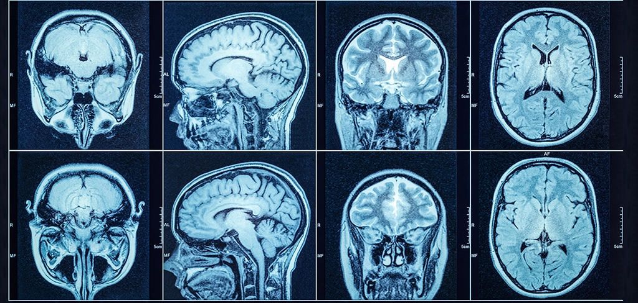
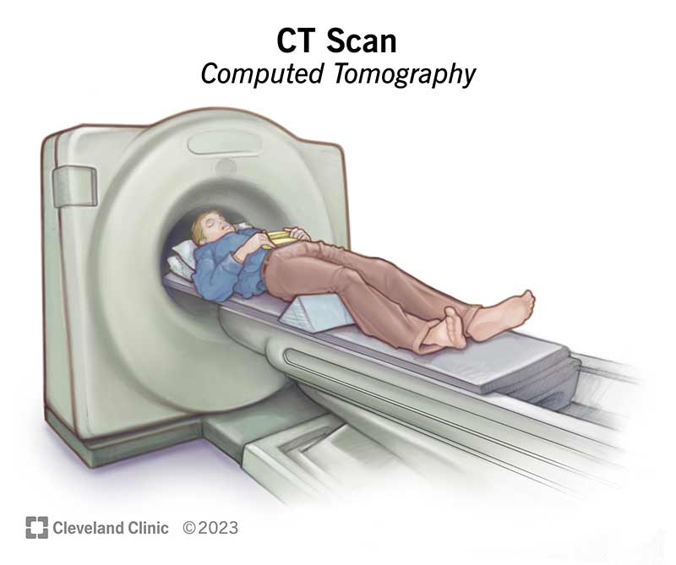
Computed Tomography
A CT (computed tomography) scan is an imaging test that helps healthcare providers detect diseases and injuries. It uses a series of X-rays and a computer to create detailed images of your bones and soft tissues.
Fig. 6 A head CT scan produces cross-sectional images of the brain using X-rays, helping to diagnose conditions like stroke, tumors, or trauma[6].

Slide 12
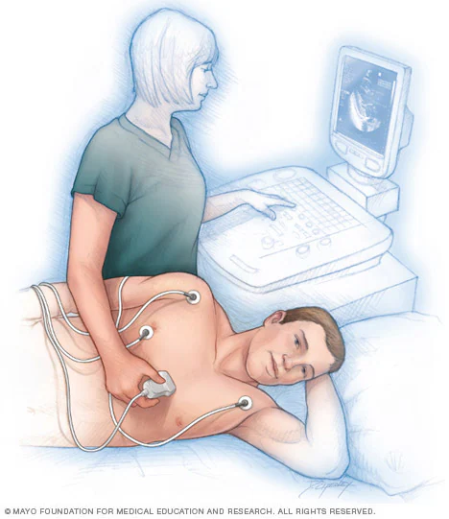
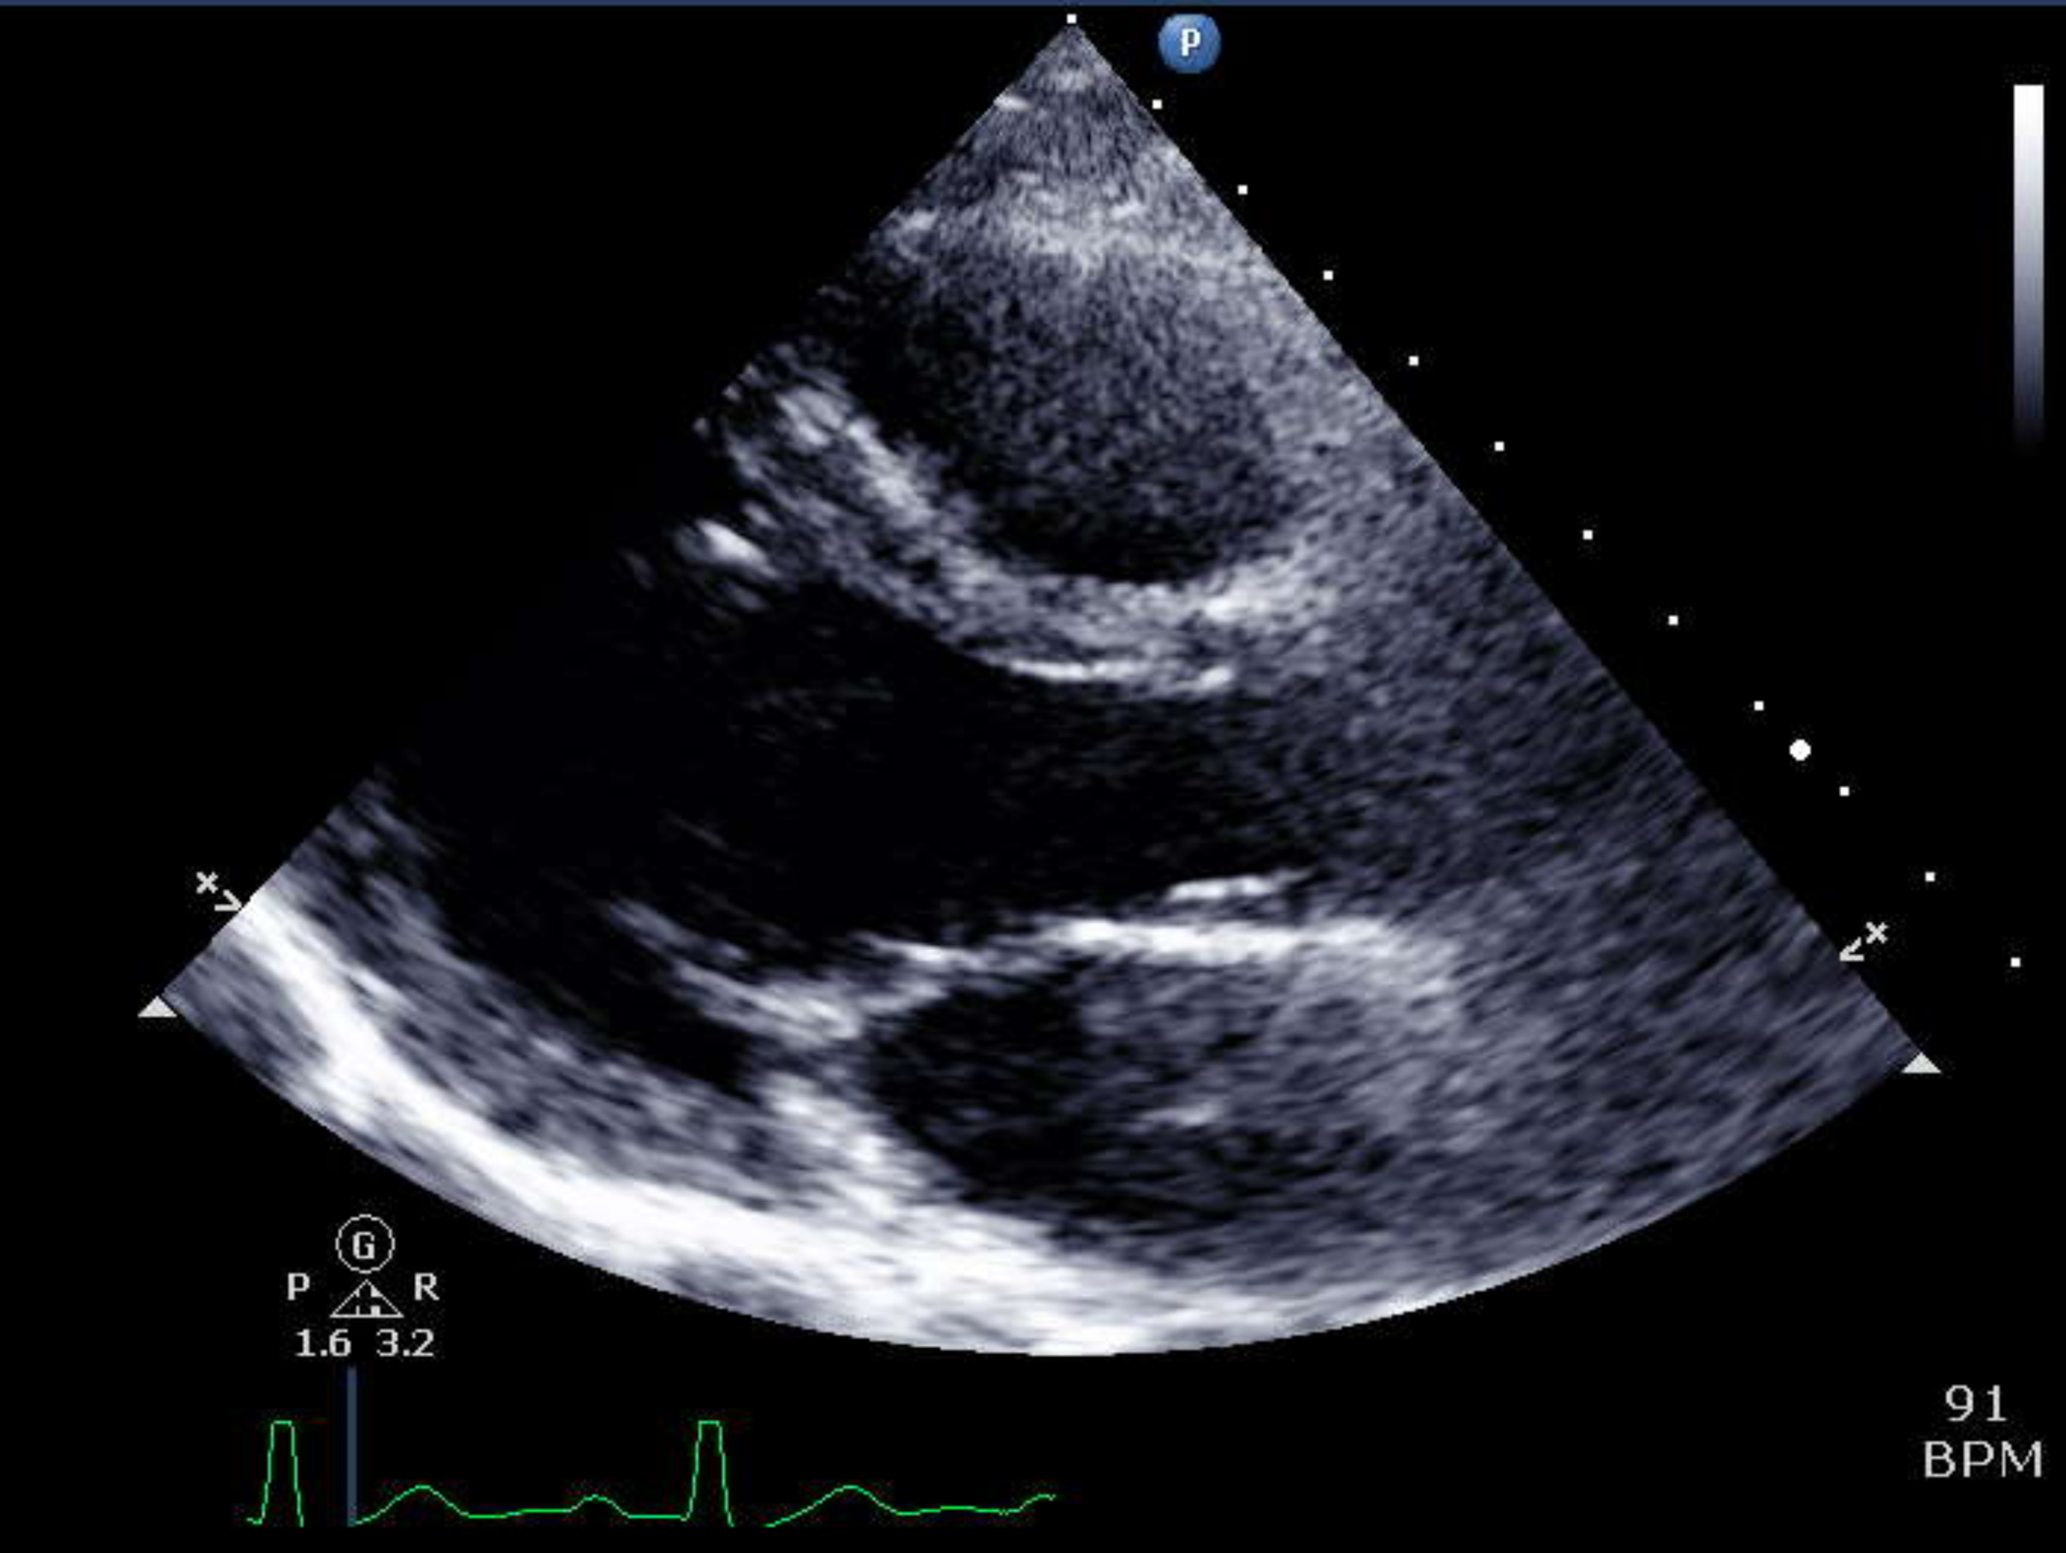
Echocardiogram
An echocardiogram uses sound waves to create pictures of the heart. This common test can show blood flow through the heart and heart valves.
Fig. 7 Echocardiograms use ultrasound to visualize heart structures and assess function in real time. Adapted from gponline.com [7].

Slide 13
Summary
Biopotentials are critical in medical diagnostics and research.
Each modality has a unique frequency and amplitude range.
Proper understanding of signal characteristics enhances signal acquisition, filtering, and clinical interpretation.

Slide 14
Reference
[1] “ECG interpretation: Characteristics of the normal ECG (P-wave, QRS complex, ST segment...),” ECGWaves, [Online]. Available: https://ecgwaves.com/topic/ecg-interpretation-normal-ecg. [Accessed: May 5, 2025].
[2] “Electromyography (EMG),” EBME & Clinical Engineering Articles, [Online]. Available: https://www.ebme.co.uk/articles/clinical-engineering/electromyography-emg. [Accessed: May 1, 2025].
[3] P. A. Abhang and S. C. Mehrotra, Introduction to EEG- and Speech-Based Emotion Recognition, 2016. [Online]. Available: https://link.springer.com/chapter/10.1007/978-81-322-2674-1_2. [Accessed: May 1, 2025].
[4] Karlyn, “Electroneurograma (ENG),” SlideServe, [Online]. Available: https://www.slideserve.com/karlyn/electroneurograma-eng. [Accessed: May 1, 2025].
[5] R. H. McAnany et al., “Negative electroretinograms: genetic and acquired causes, diagnostic approaches and physiological insights,” Nature Communications, vol. 12, no. 1, Article 4160, Jul. 2021. [Online]. Available: https://www.nature.com/articles/s41433-021-01604-z. [Accessed: May 1, 2025].
[6] “What Should I Expect From A Head CT Scan?” South Jersey Radiology Associates, Nov. 6, 2023. [Online]. Available: https://sjra.com/what-should-i-expect-from-a-head-ct-scan. [Accessed: May 1, 2025].
[7] “Making sense of an echocardiogram report – for GPs!,” GPonline, Jan. 29, 2019. [Online]. Available: https://www.gponline.com/making-sense-echocardiogram-report-gps/article/1524892. [Accessed: May 1, 2025].

